Slide 1
Confidence intervals for a population proportion

Slide 2
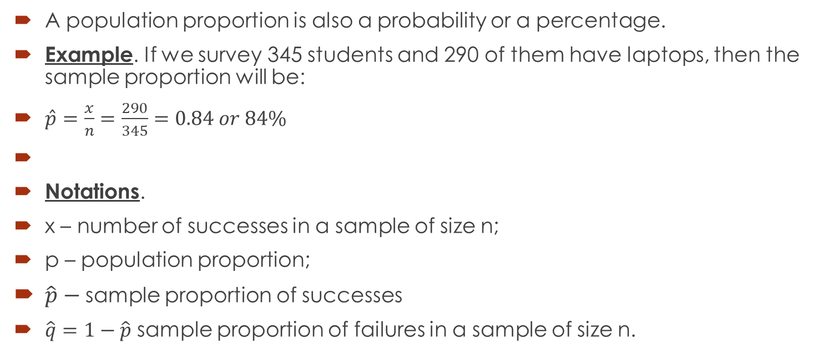
Confidence intervals for a population proportion
A population proportion is also a probability or a percentage.
Example. If we survey 345 students and 290 of them have laptops, then the sample proportion will be:
$\hat{p}=\frac{x}{n}=\frac{290}{345}=0.84 or 84\%$
Notations.
x – number of successes in a sample of size n;
p – population proportion;
$\hat{p}−$sample proportion of successes
$\hat{q}=1−\hat{p}$ sample proportion of failures in a sample of size n.

Slide 3
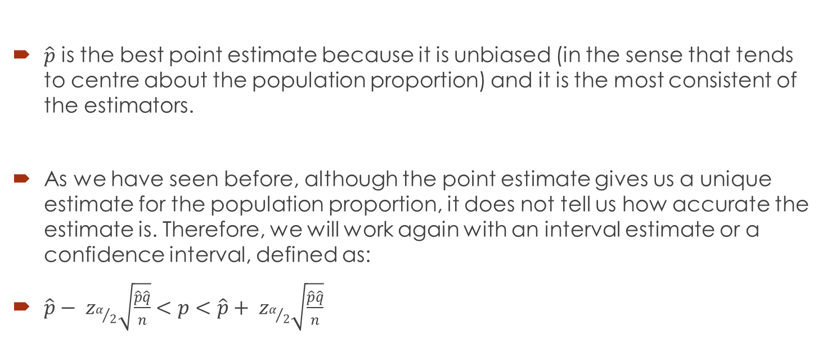

The proportion $\hat{p}$ is the best point estimate of the population proportion.
$\hat{p}$ is the best point estimate because it is unbiased (in the sense that tends to centre about the population proportion) and it is the most consistent of the estimators.
As we have seen before, although the point estimate gives us a unique estimate for the population proportion, it does not tell us how accurate the estimate is. Therefore, we will work again with an interval estimate or a confidence interval, defined as:
$\hat{p}− z_{α/2}\sqrt{\frac{\hat{p}\hat{q}}{n}}<p<\hat{p}+ z_{α/2}\sqrt{\frac{\hat{p}\hat{q}}{n}}$

Slide 4

Check for these conditions…
This formula is applicable if the following statements are true:
The sample has been collected randomly.
The 4 statements that describe a binomial experiment are true.
The conditions for using a normal distribution to approximate the distribution of sample proportions are satisfied: p is large enough, $np≥5 and nq≥5$.

Slide 5

The margin of error
As usual, the 2 factors affecting the margin of error are:
The level of confidence;
The sample size.
We use the margin of error formula:
$E= z_{α/2}\sqrt{\frac{\hat{p}\hat{q}}{n}}$

Slide 6
Example 1
E
A major metropolitan newspaper selected a simple random sample of 1,600 readers from their list of 100,000 subscribers. They asked whether the paper should increase its coverage of local news. Forty percent of the sample wanted more local news. What is the 99% confidence interval for the proportion of readers who would like more coverage of local news?

Slide 7
Solution
The sampling method must be simple random sampling. This condition is satisfied; the problem statement says that we used simple random sampling.
Suppose we classify a "more local news" response as a success, and any other response as a failure. Then, we have 0.40 * 1600 = 640 successes, and 0.60 * 1600 = 960 failures - plenty of successes and failures.
Construct a confidence interval:
Identify a sample statistic. Since we are trying to estimate a population proportion, we choose the sample proportion (0.40) as the sample statistic.
Select a confidence level. In this analysis, the confidence level is defined for us in the problem. We are working with a 99% confidence level.

Slide 8
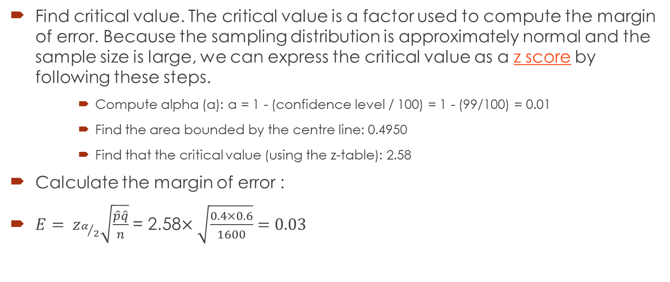
Solution - continued
Find critical value. The critical value is a factor used to compute the margin of error. Because the sampling distribution is approximately normal and the sample size is large, we can express the critical value as a z score by following these steps.
Compute alpha (α): α = 1 - (confidence level / 100) = 1 - (99/100) = 0.01
Find the area bounded by the centre line: 0.4950
Find that the critical value (using the z-table): 2.58
Calculate the margin of error :
$E= z_{α/2}\sqrt{\frac{\hat{p}\hat{q}}{n}}$ = 2.58$×\sqrt{\frac{0.4×0.6}{1600}}=0.03$

Slide 9
Practice Question 1
A survey involving 300 customers, showed that 1 out of 5 customers return to a certain company for the oil change on their cars. Construct a 95% confidence interval for the population proportion.

Slide 12
Question 2
Suppose that a market research firm is hired to estimate the percent of adults living in a large city who have cell phones. Five hundred randomly selected adult residents in this city are surveyed to determine whether they have cell phones. Of the 500 people sampled, 421 responded yes – they own cell phones. Using a 92% confidence level, compute a confidence interval estimate for the true proportion of adult residents of this city who have cell phones.

Slide 14
Question 3
Suppose 250 randomly selected people are surveyed to determine if they own a tablet. Of the 250 surveyed, 98 reported owning a tablet. Using a 90% confidence level, compute a confidence interval estimate for the true proportion of people who own tablets.

